Slide 1

R Analysis of
Grand Data Auto: Vice City
December 8, 2025
Abrar Faruque
Brenda Soljic
Sam Lenet
BINF5003: DATA MINING, MODELING, AND BIOSTATISTICS

Slide 2
UNDERSTANDING STEAM REVIEWERS IN GTA: VICE CITY
R Analysis of Grand Data Auto: Vice City
Video game success is strongly shaped by marketing and user perception
Steam reviews offer valuable insight into player behaviour
GTA: Vice City provides a large dataset of user reviews and analysis
Our goal: identify behavioural groups based on engagement, writing effort, and platform activity

Slide 3
RESEARCH QUESTION
R Analysis of Grand Data Auto: Vice City
What are characteristic behaviours in individuals who play Grand Theft Auto: Vice City, based on their reviews?

Slide 4
BACKGROUND | INTRODUCTION
R Analysis of Grand Data Auto: Vice City
The Grand Data Auto Vice City dataset examines the reviews from the popular video game Grand Theft Auto: Vice City, with variables including:
ID | 9 digit code for each player
Review | Text content of the review
Voted Up | TRUE = positive review; FALSE = negative review
Votes_Up and Comment_Count | Capture community interaction
Author Playtime Metrics (minutes) | Playtime_forever - total lifetime playtime Playtime_last_two_weeks - recent activity level Playtime_at_review - playtime at the moment the review was posted Values reflect data as of February 2025

Slide 5
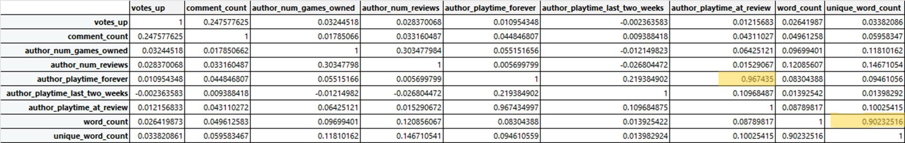
VARIABLE SUMMARY
R Analysis of Grand Data Auto: Vice City
Strong correlation in Word count versus Unique word count, Play time at review and Playtime Forever (highlighted)
All other variables show weak correlation

Slide 6
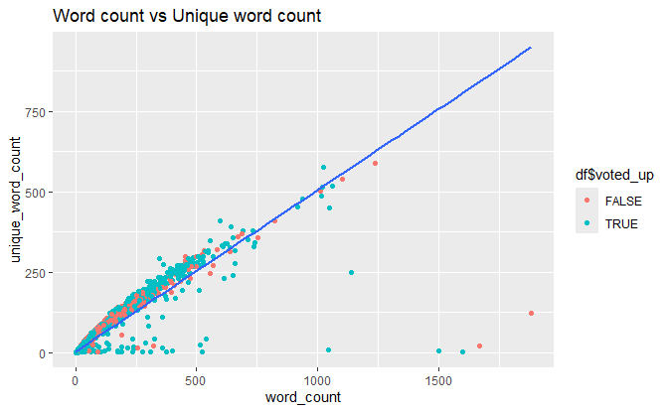
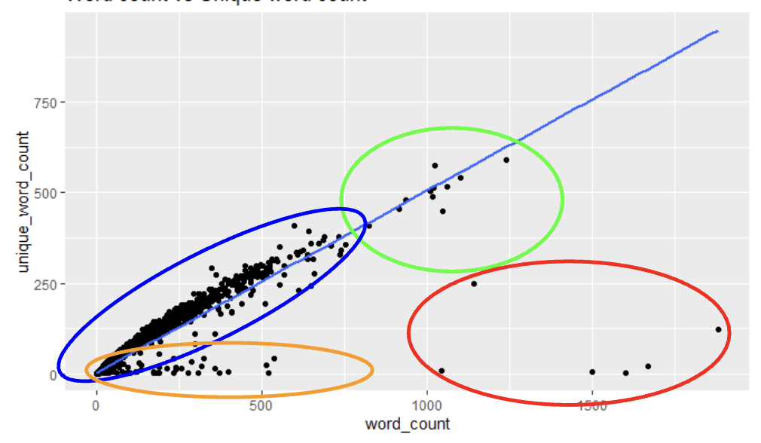
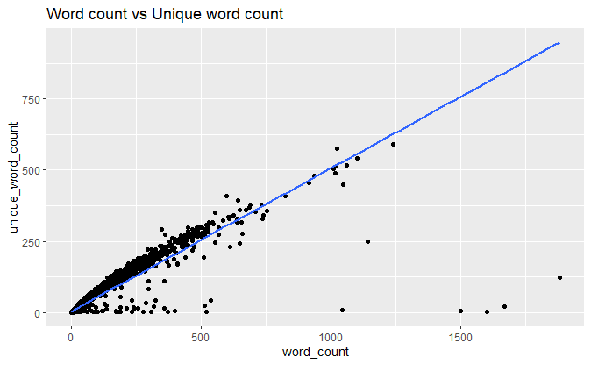
Figure 1:
Orange(subgroup 1): <1000 words and <100 unique words
Blue(subgroup 2): 1-500 words and <1000 unique words
Green(subgroup 3): ≥1000 words and >500 unique words
Red(subgroup 4): >1000 words and <500 unique words
Overall
No significant pattern between positive or negative (TRUE or FALSE) review in any subgroup
DETERMINING EFFORT
R Analysis of Grand Theft Auto: Vice City
WORD COUNT VS UNIQUE WORD COUNT

Slide 7
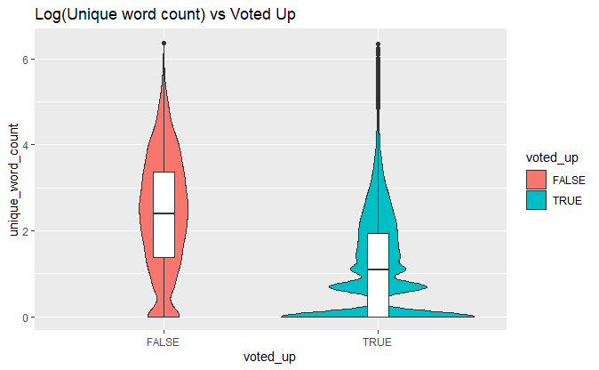
Figure 2:
Negative (voted_up = FALSE)
  Follows a normal distribution
  Cluster of short, low-worded reviews
Positive (voted_up = TRUE)
  Does NOT follow a normal distribution until average Log
  Unique word count = 1, extremely common
    Single word reviews making up 32.95% of all pos reviews
DETERMINING EFFORT
R Analysis of Grand Theft Auto: Vice City
LOG (UNIQUE WORD COUNT) VS VOTED UP

Slide 8
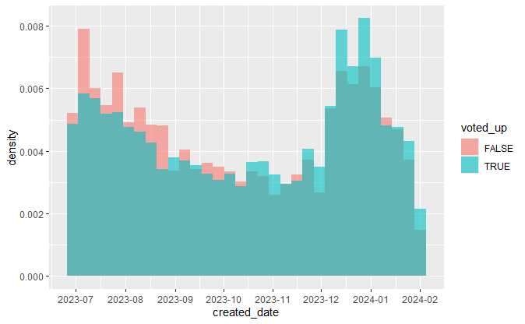
Figure 3:
Number of reviews (June 27, 2023 - Feb 1, 2024) split by voted_up TRUE vs FALSE
June-October 2023:
  More negative (FALSE) reviews than positive (TRUE)
After October 2023:
  Positive (TRUE) reviews become more frequent than negative (FALSE)
December 2023 spike:
  Review count more than doubled compared to November
DETERMINING EFFORT
R Analysis of Grand Theft Auto: Vice City
DISTRIBUTION OF REVIEWS AND TIME

Slide 9
DISCUSSION & CONCLUSION
R Analysis of Grand Data Auto: Vice City
Determining Effort
No formal “effort” metric, but higher world count + more unique words = higher effort
Word count and unique word count are strongly correlated

Slide 10
DISCUSSION & CONCLUSION
R Analysis of Grand Data Auto: Vice City
Cluster Characteristics
Subgroups 2 & 3:
  Most reviews
  Roughly 2:1 ratio of total words to unique words
  Brief to moderately expressive reviews
Subgroups 1 & 4:
  Smaller groups
  Low unique word diversity relative to length
  Many contained repeated words/phrases
Effort does NOT predict voted_up outcome
  No correlation between writing effort and positive vs negative reviews

Slide 11
DISCUSSION & CONCLUSION
R Analysis of Grand Data Auto: Vice City
Reviewer Behaviour Trends
Positive (TRUE) reviews:
  Require less effort, extremely short
Negative (FALSE) reviews:
  Longer, contain more unique words
Two reviewer archetypes emerge:
  “Simpleton” - very short, positive feedback
  “Critic” - longer, detailed negative feedback

Slide 12
DISCUSSION & CONCLUSION
R Analysis of Grand Data Auto: Vice City
Influence of Canonical Events on Reviews
June - November 2023:
  Negative reviews outnumbered positive reviews
After December 2023:
  Positive reviews became more common
  Coincides with a major game update fixin serval issues
  Aligns with the GTA 6 announcement

Slide 13
DISCUSSION & CONCLUSION
R Analysis of Grand Data Auto: Vice City
Timing and Playing Relationship
No significant correlation between:
  When players bought the game (author_plaaytime_forever)
  When they wrote their review (author_playtime_at_review)

Slide 14
REFERENCES
R Analysis of Grand Theft Auto: Vice City
Guzsvinecz, T., & Szűcs, J. (2023, December). Length and sentiment analysis of reviews about top-level video game genres on the steam platform. ELSEVIER. https://www.med.upenn.edu/pmi/events/https-www-sciencedirect-com-science-article-abs-pii-s1047847720300046-via-3dihub
Lutz, B., Prollochs, N., & Neumann, D. (2019, September). The Longer the Better? The Interplay Between Review Length and Line of Argumentation in Online Consumer Reviews. arXiv. http://arxiv.org/pdf/1909.05192
Mellinas, J. P., & Leoni, V. (2024, September). Beyond words: unveiling the implications of blank reviews in online rating systems. SpringerLink. https://link.springer.com/article/10.1007/s40558-024-00300-4
Statista. (2025, August). Grand Theft Auto V Total Unit Sales 2025. Statista. https://www.statista.com/statistics/1247955/gta-v-unit-sales-worldwide-total/#statisticContainer
Zhong, X., & Xu, J. (2022, June). Measuring the effect of game updates on player engagement: A cue from DOTA2. Research Gate. https://www.researchgate.net/publication/361091263_Measuring_the_effect_of_game_updates_on_player_engagement_A_cue_from_DOTA2

Slide 15
Thank you
Questions?

